Slide 1

Frito-Lay; Attrition; root causes and business impact
For Frito-Lay leadership, By Ben Goodwin

Slide 2
Why discuss attrition?
Attrition (n): Refers to employee or staff turnover, but in a broader sense, attrition rate is a calculation of the number of individuals or items that vacate or move out of a larger, collective group over a specified time frame.
Prior to discussion of root causes, what is the outcome if we address attrition?
Employee Retainment (longer)
Employee satisfaction
Reduce costs associated with employee turnover
Showcase Frito-Lay as a great place to work
Fundamental underpinning: Attrition impacts the bottom line of the business

Slide 3
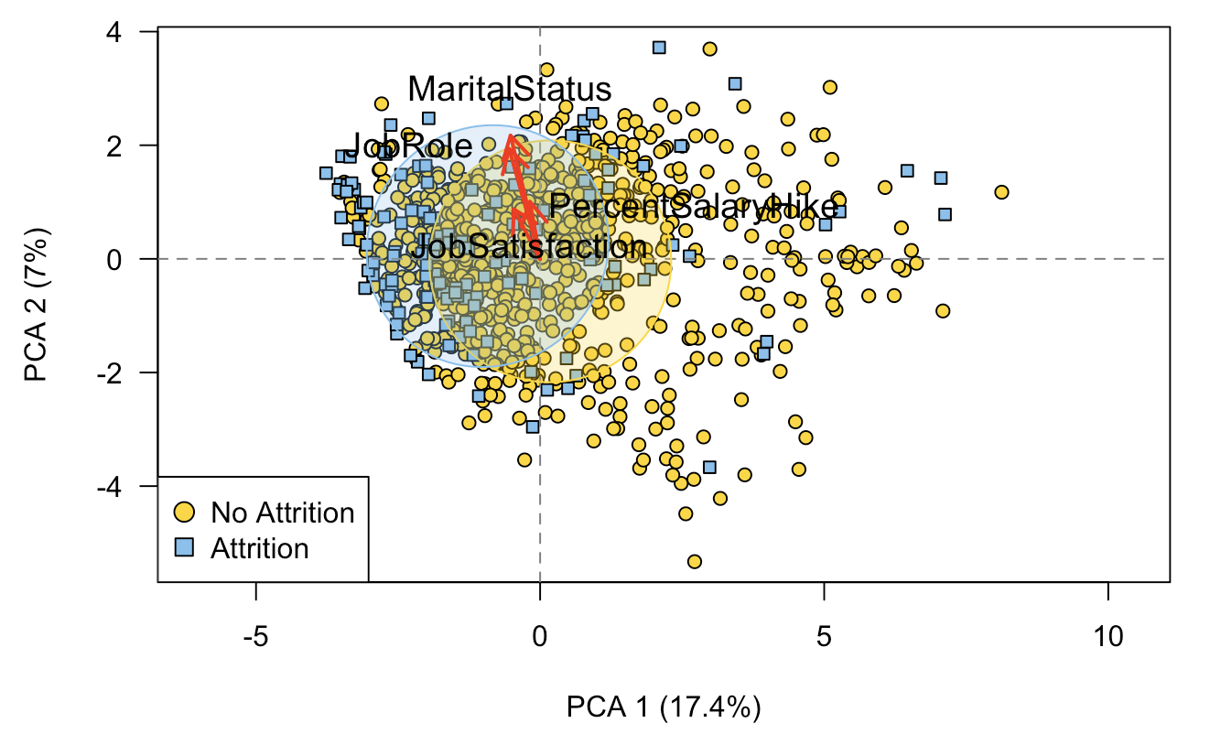
Attrition Visualized
Data contains ~30 variables on employee retention.
Unlikely one variable explains employee attrition
Principal component analysis used for dimensionality reduction to generalize attrition
PC1: Associated with total working years, job level, and monthly income. This component is a primary measure of career length and longevity and is a measure of success.
PC2: Associated with years with current manager and years in current role.
Attrition Takeaway: Between PC1 and PC2 we can see that job role and marital status play a large role in attrition.
Benefit: Marital status is largely outside of work; simple remedy of more PTO, potentially refocuses noncommitted workforce
Risk: Increased homelife stress will come into work and impact business operations
Notes:
###Interpretation of PC1 and PC2###
The first component is positively correlated with total working years, years at company, job level, monthly income. This suggests the give variables vary together and when one goes down, the others decrease as well. The component could be considered a primary measure of career length and longevity and well as a measure of success. #The second component is mostly correlated with number of companies worked, and age, but in a negative direction. Years with current manager and years in current role are correlated with the second component in the positive direction, which indicates that as number of companies and age decrease, years with current manager and years in current role increase. #Looking at the biplot, we can see the loadings that point in the direction of the attrition ellipse. In terms of the first component, we can see that Job Role and Marriage Status point more towards the attrition ellipse. The same with Job Satisfaction and percent salary hike for the second component.

Slide 4
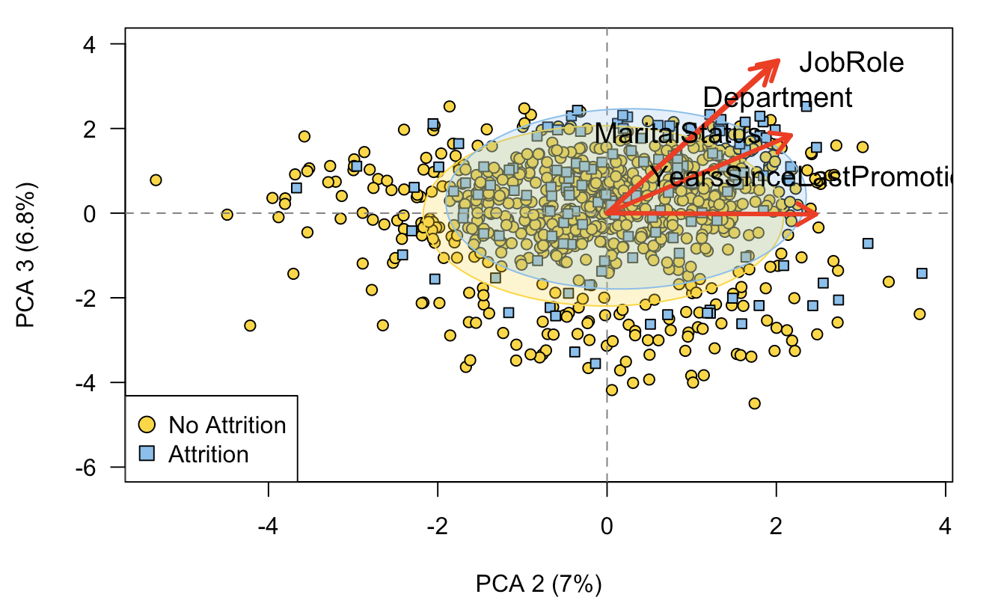
Attrition Visualized
PC3: This component is most related with performance rating and percent salary hike, both in a negative direction, suggesting that as a performance rating and percent salary hike decrease, department and job role increase.
Attrition Takeaway: Between PC2 and PC3 we can see once again job role and marital status are highly associated with attrition.
Benefit: Salary increases are an expense, but they pale in comparison to onboarding costs
Risk: Low salaries cause attrition, Frito-Lay cannot focus on growth, constant internal struggles
Notes:
###Interpretation of PC3#### #The third component is most correlated with performance rating and percent salary hike, both in a negative direction. Department and job role are correlated with the third component in a positive direction, suggesting that as performance rating and percent salary hike decrease, department and job role increase. #Looking at the biplot, we can see the loadings that point in the direction of the attrition ellipse. In terms of the third component, we can see that department and job role point more towards the attrition ellipse, this is the second biplot that job role has pointed towards attrition, suggesting this may be a variable of interest concerning attrition.

Slide 5
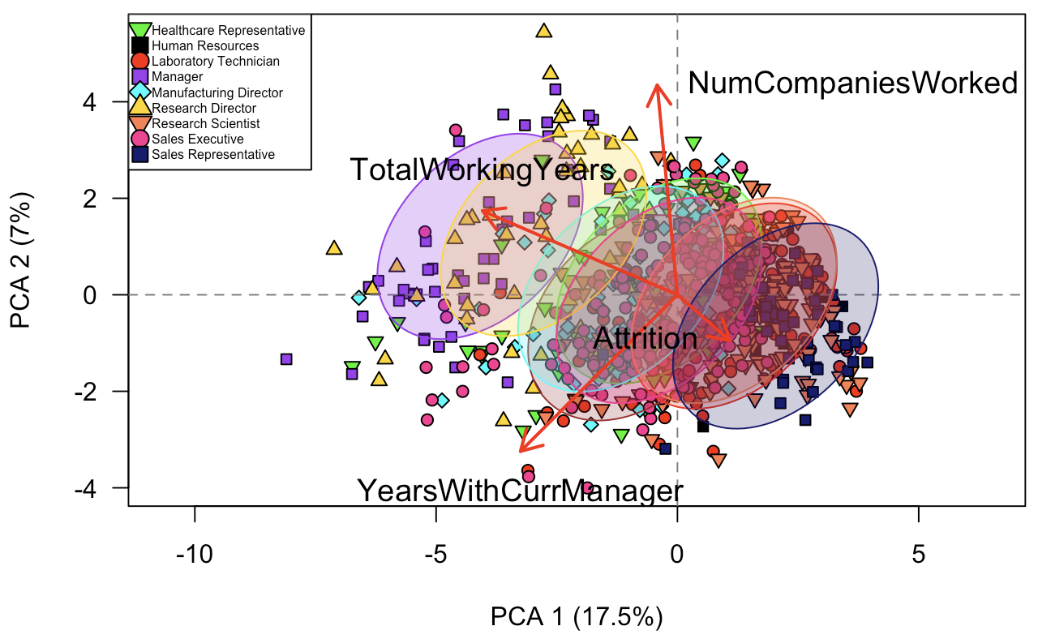
Job Role Attrition Visualized
Attrition Takeaway: Certain roles are at a higher risk of attrition. Focus on retaining sales representatives, sales executives, and research scientists.
Benefit: Frito-Lay can focus on certain job roles that suffer from increased attrition
Risk: Attrition job roles are heavy on the sales side; this needs immediate action. This can be directly attributed to losses in sales.
Notes:
###Interpretation of PC3#### #The third component is most correlated with performance rating and percent salary hike, both in a negative direction. Department and job role are correlated with the third component in a positive direction, suggesting that as performance rating and percent salary hike decrease, department and job role increase. #Looking at the biplot, we can see the loadings that point in the direction of the attrition ellipse. In terms of the third component, we can see that department and job role point more towards the attrition ellipse, this is the second biplot that job role has pointed towards attrition, suggesting this may be a variable of interest concerning attrition.

Slide 6
Frito-Lay should focus on reducing sales staff attrition and increase salaries
Aggregating all variables via dimensionality reduction indicates that marital status and salary hike point towards attrition.
When all job categories are plotted, certain job roles within the sales realm are heavily associated with attrition.
Next Steps:
Frito-Lay will be unable to address growth opportunities and should consider being more generous with paid time off to incentivize employees to strive for more work life balance.
Leadership should also consider raising salaries to address the variable salary hike. Despite the initial costs of increases salaries, conventional wisdom tells us that increases salaries of existing employees instead of bringing on new employees will reduce costs in the long run
As a result of these two actions, existing employees will stay, and Frito-Lay can shift its resources elsewhere to focus on growing sales, increasing footprint, and reducing overhead.

